Slide 1
CASTING PRODUCTION MANAGEMENT SYSTEM
GOKUL L
16.10.2024

Slide 2
AIM:
To automate the casting production process for improved efficiency.
To track inventory at each production stage.
To calculate profit or loss based on production costs and sales revenue.

Slide 3
Business Problem or Problem Statement:
The manufacturing industry often faces inefficiencies in tracking production stages and managing inventory.
Lack of automated systems can lead to delays, increased costs, and decreased profitability.
This project addresses these challenges by implementing a streamlined production system.

Slide 4
Project Description:
Overview: The Casting Production System simulates the complete production process, from casting production to packing and disposal.
Scope: Covers production tracking, quality inspection, and financial calculations.
Technologies Used: Python for implementation; OOP principles for code organization.
Key Features:
Real-time stock tracking.
Profit and loss calculation.

Slide 5
Functionalities:
Production of Castings: Allows input for the number of castings produced.
Machining Process: Moves castings to machining, with stock validation.
Quality Inspection: Evaluates castings and categorizes them into accepted,
on-hold, or rejected.
On-Hold Management: Handles castings that are on hold for further
inspection.
Profit Calculation: Computes profit or loss based on sales and production
costs.

Slide 6
Functionalities:
Reporting: Provides detailed reports of stock levels and financial summaries.
Error Handling: Ensures robust input handling to prevent negative values and invalid entries.

Slide 7
Input Versatility with Error Handling and Exception Handling:
The system handles various user inputs through prompt messages.
Error Handling:
Checks for negative input and raises exceptions.
Provides feedback for invalid entries.
Example: If a user inputs a negative number for castings, the program will raise a Value Error and prompt for valid input.

Slide 8
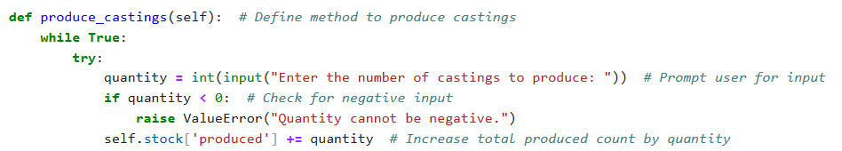
Code Implementation:
Key Algorithms: Sequential methods for each production stage.
Data Structures: Utilizes a dictionary to track stock levels.
Code Organization: Modular design with clear method definitions.
Code Snippet Example:

Slide 9
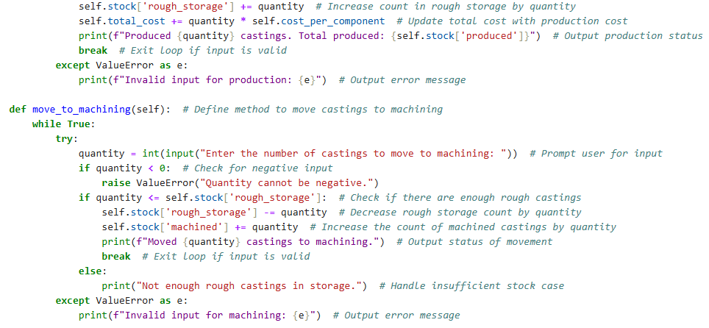
Code Implementation:

Slide 10
Results and Outcomes:
Successfully simulates the casting production process.
Users can track production metrics in real time.
Example Results:
Number of castings produced: [X]
Total Revenue: [Y] Rupees
Profit/Loss: [Z] Rupees

Slide 11
Conclusion:
The Casting Production System effectively addresses inefficiencies in the production process.
It provides comprehensive tracking and financial analysis.
Future Developments: Potential to integrate with real-world manufacturing systems and further automate processes.
Thank you for your attention!

Slide 12
Questions & Discussion:
Any Questions?
Suggestions for Improvement?

Slide 13

THANK YOU ALL

